Slide 1

Capstone Engagement
Assessment, Analysis, and Hardening of a Vulnerable System
Presented by Jennifer Zinn

Slide 2
Table of Contents
This document contains the following sections:
01
Network Topology
02
Red Team: Security Assessment
03
Blue Team: Log Analysis and Attack Characterization
Hardening: Proposed Alarms and Mitigation Strategies
04

Slide 3

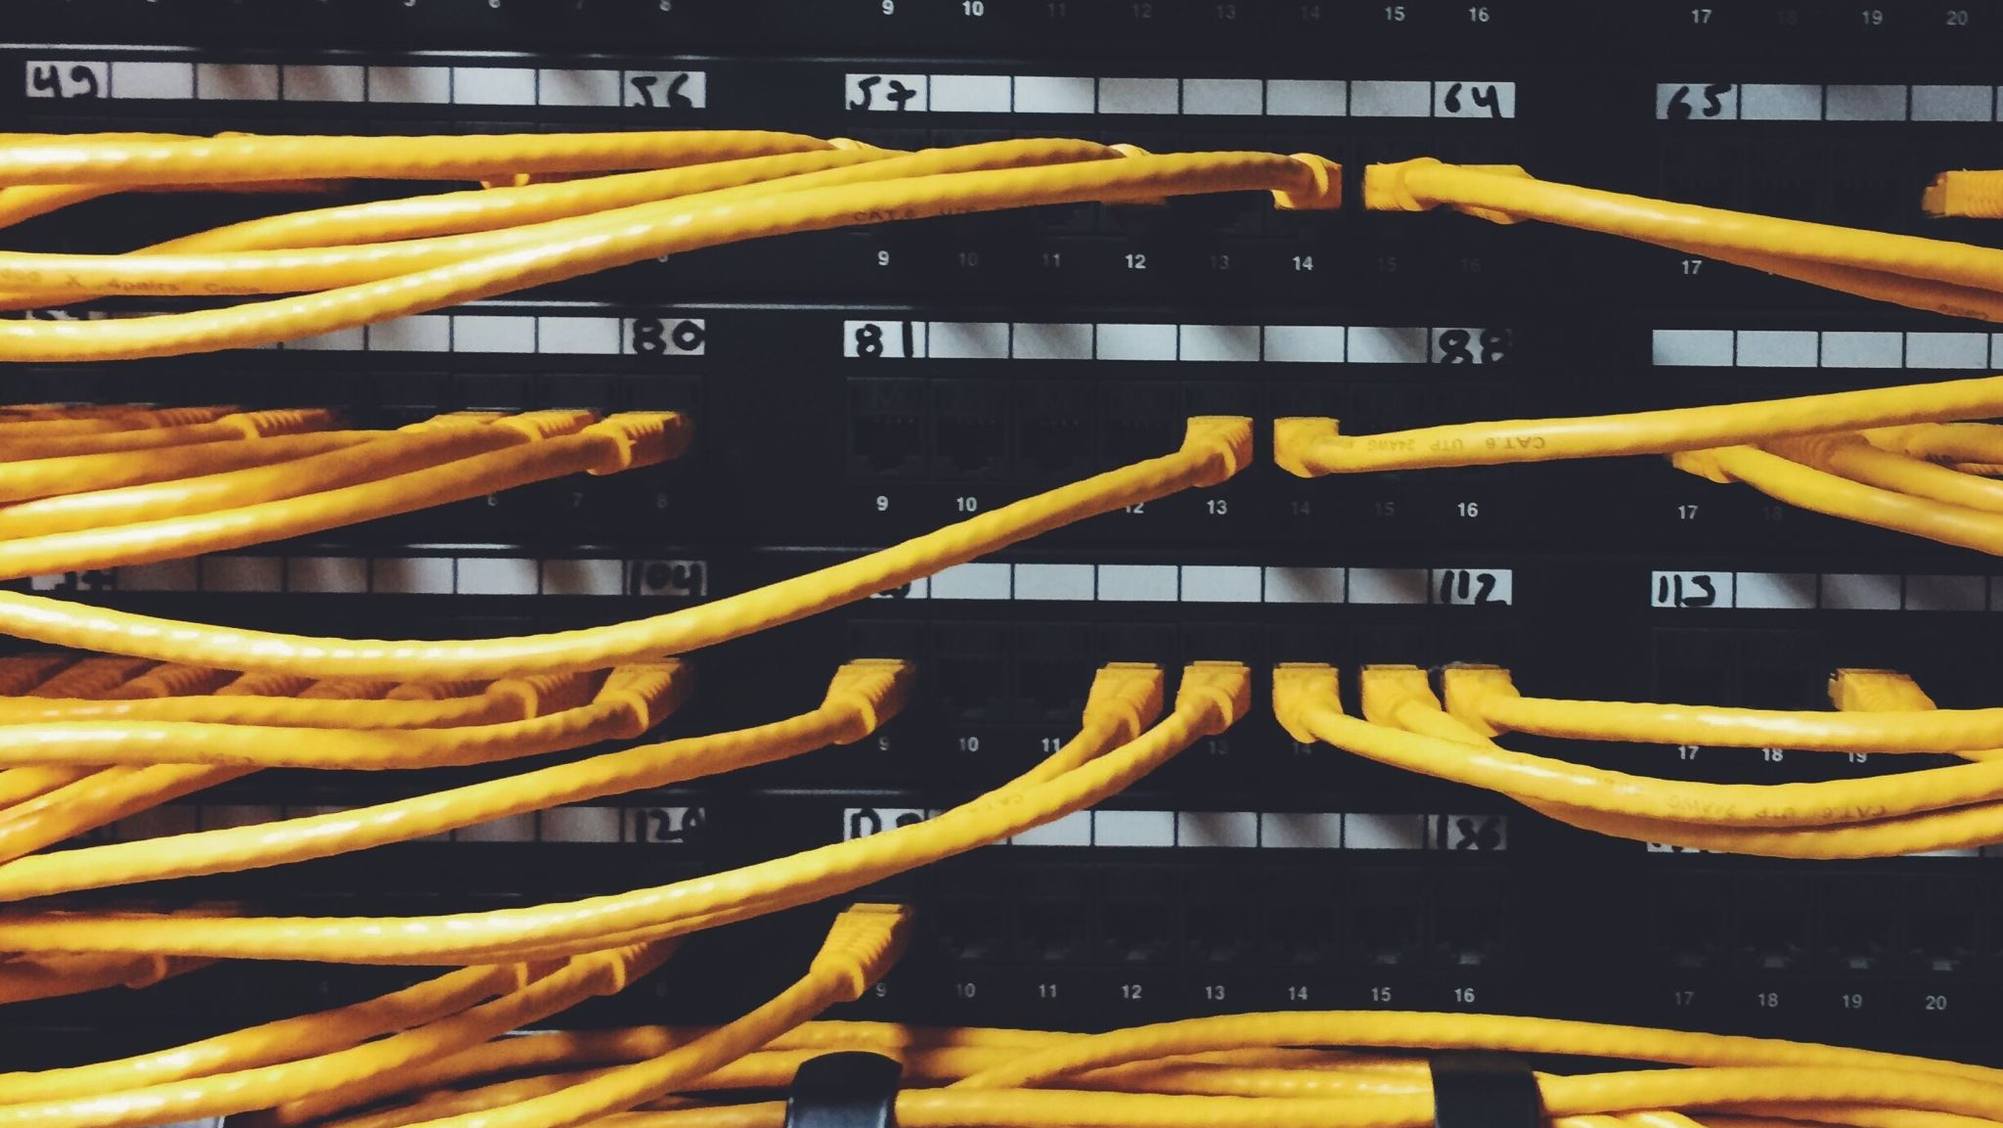
Network Topology
3

Slide 4
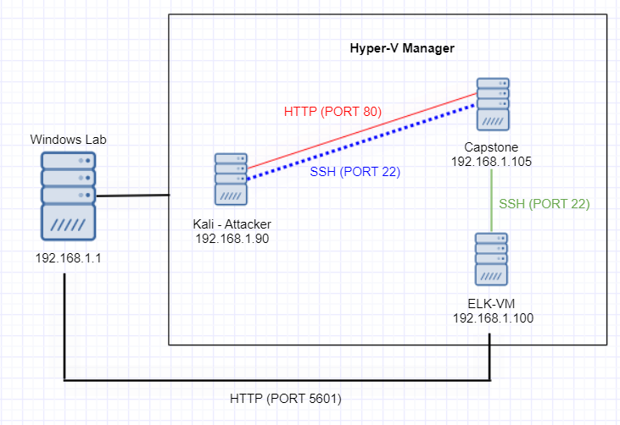
Network Topology
Network
Address Range: 192.168.1.0/24
Netmask: 255.255.255.0
Gateway: 10.0.0.1
Machines
IPv4: 192.168.1.1
OS: Windows 10
Hostname: Windows Lab
IPv4: 192.168.1.90
OS: Kali Linux
Hostname: Kali
IPv4: 192.168.1.100
OS: Ubuntu Linux
Hostname: ELK
IPv4: 192.168.1.105
OS: Ubuntu Linux
Hostname: Capstone

Slide 5
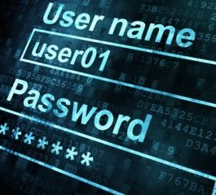
Red Team
Security Assessment
This Photo by Unknown Author is licensed under CC BY-NC-ND
5

Slide 6
Recon: Describing the Target
The following hosts were identified on the network:
Hostname | IP Address | Role on Network
Kali | 192.168.1.90 | Red Team offensive attack machine
Capstone | 192.168.1.105 | Vulnerable VM web server
ELK | 192.168.1.100 | Kibana for Incident Analysis
Windows Lab | 192.168.1.1 | Hyper-V VM manager

Slide 7
Vulnerability Assessment
The assessment uncovered the following critical vulnerabilities in the target:
Vulnerability | Description | Impact
CVE-2018-15919 - OpenSSH 7.6p1 | Tool for remote login with the SSH protocol. | Could be used by attackers to remotely connect and execute commands on the victim computer.
Apache httpd 2.4.29 PHP Exploit | PHP exploit allows the attacker access to the web server. | Allows attackers to gain full access to sensitive information and the ability to execute commands.
WebDav | Protocol that allows users to remotely collaborate and edit content on the web. | A reverse shell can be uploaded and compromise the server by allowing remote access.

Slide 8
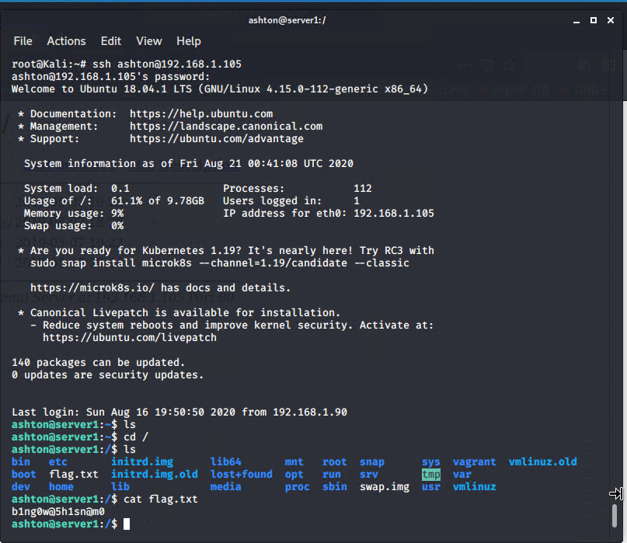
Exploitation: OpenSSH 7.6p1
Recon:
By exploring the Capstone web server using a web browser, a secret_file was found within company_folders. This file is managed by Ashton.
Process:
Ashton’s password was cracked using a Brute Force Attack (specifically, Hydra). Using the command line in Kali, access was gained by using the SSH protocol with Ashton’s username and password to remotely connect to the web server.
Achievements:
It allowed exploration of folders including the root folder where a sensitive file called flag.txt was located. It can also be used to execute commands.

Slide 9
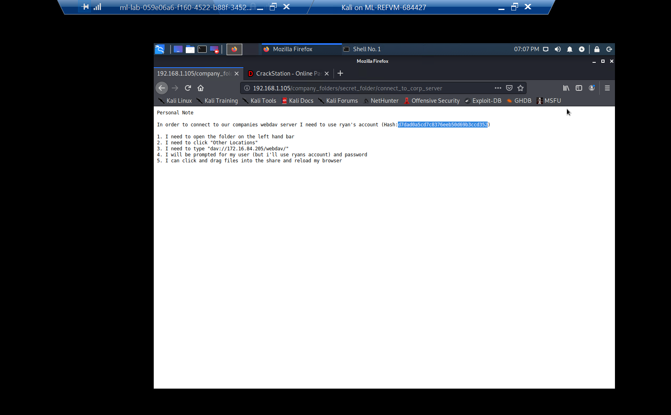
Exploitation: Apache httpd 2.4.29
Process:
Ashton’s password was cracked using a Brute Force Attack. With Ashton’s username and password, logged into the secret_folder on the Capstone web server using a web browser.
Achievements:
Ability to access secret_file and find unsecured instructions on how to access the Capstone web server using the WebDAV protocol, including Ryan’s password hash. This protocol is vulnerable to a PHP reverse shell payload.

Slide 10
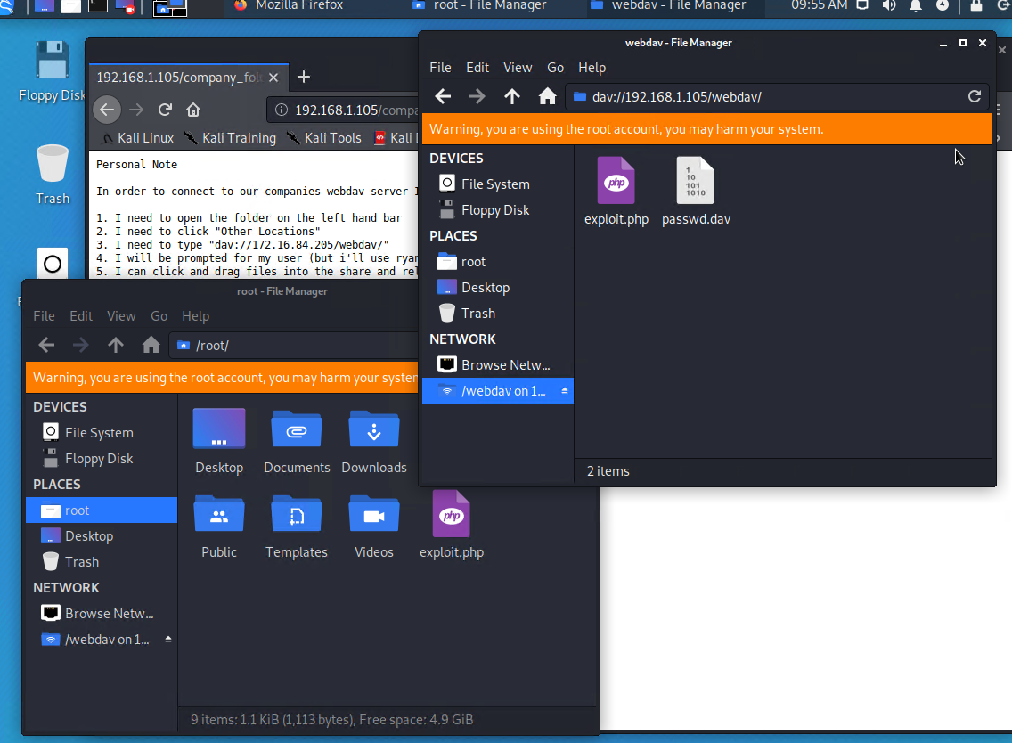
Exploitation: WebDav
Process:
A PHP reverse shell payload was created using MSFvenom. Using CrackStation, Ryan’s password hash was cracked revealing his password. Kali File Manager was used to drag and drop the payload onto the victim web server using Ryan’s credentials and the WebDAV protocol.
Achievements:
Ability to establish a reverse shell after uploading and opening the PHP payload on the victim system. The payload opened a listener on port 4444. Using Metasploit, the PHP reverse shell exploit was used to allow remote connection to the web server and explore folders, including the root folder.

Slide 11

Blue Team
Log Analysis and Attack Characterization
This Photo by Unknown Author is licensed under CC BY-NC
11

Slide 12
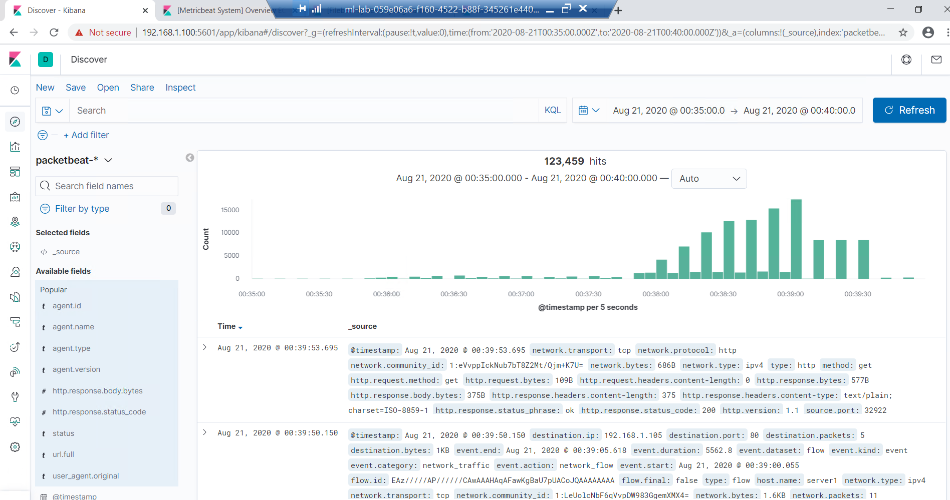
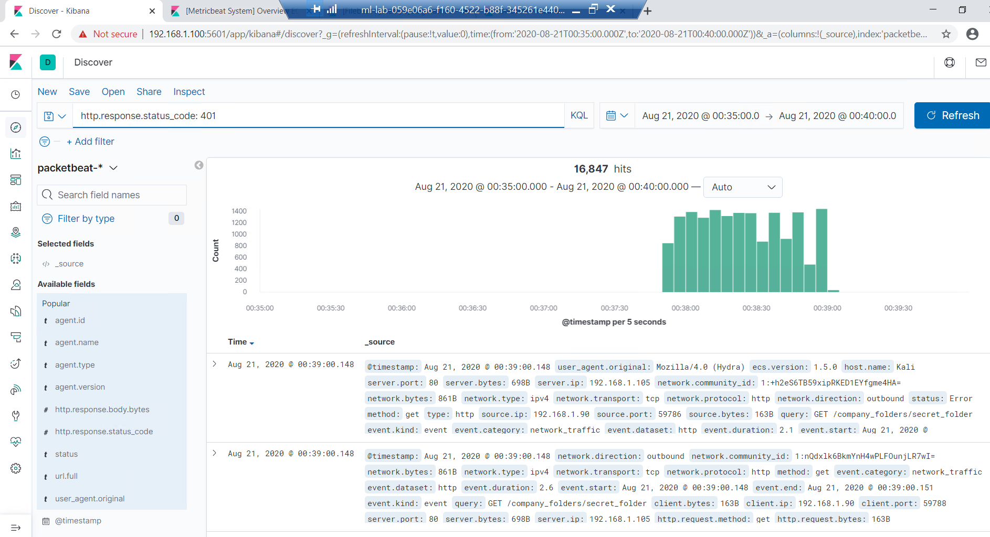
Analysis: Identifying the offensive traffic
Traffic between the attacker Kali and Capstone victim web server took place between 12:35 and 12:40 on August 21st. There were 123,459 responses. The Blue Team is most concerned with http status code 401 which indicates unauthorized access.

Slide 13
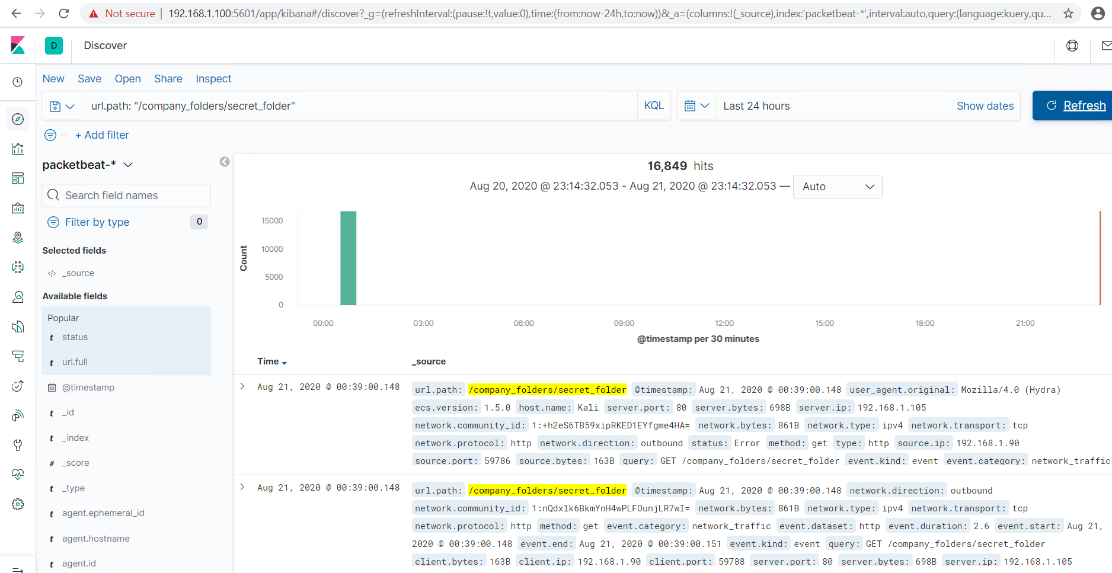
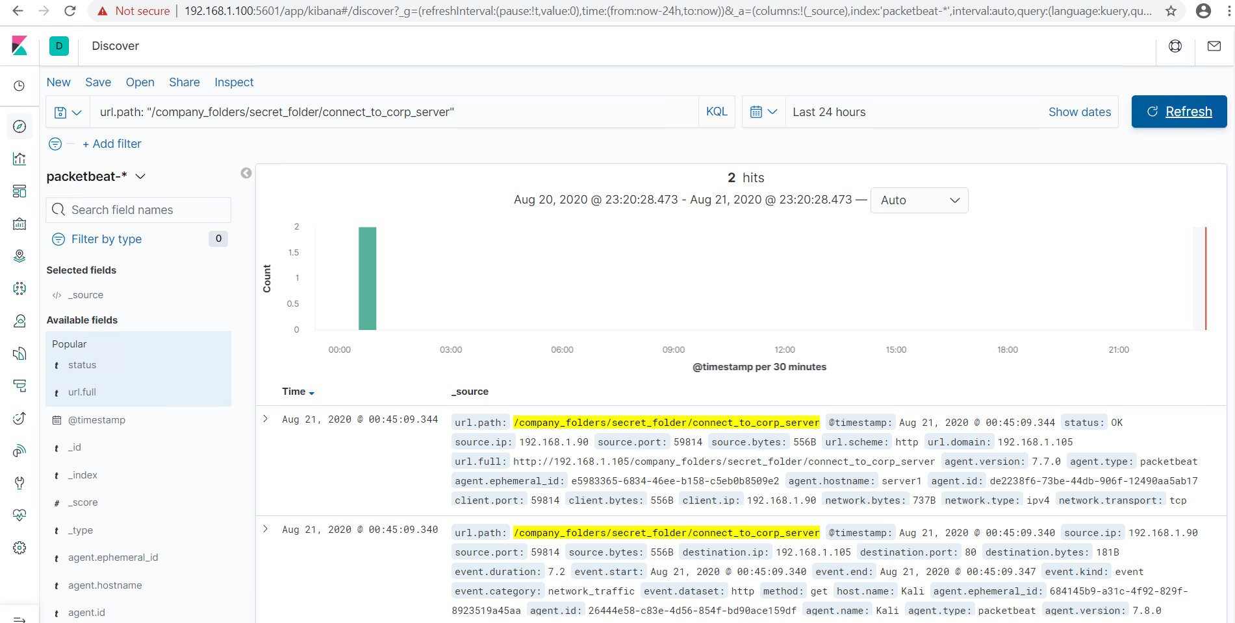
Analysis: Finding the Request for the Hidden Directory
The hidden directory “secret_folder” was accessed 16,849 times around 12:39. The IP address the requests were coming from is 192.168.1.90. It contained a file called “connect_to_corp_server” which was accessed 2 times.

Slide 14
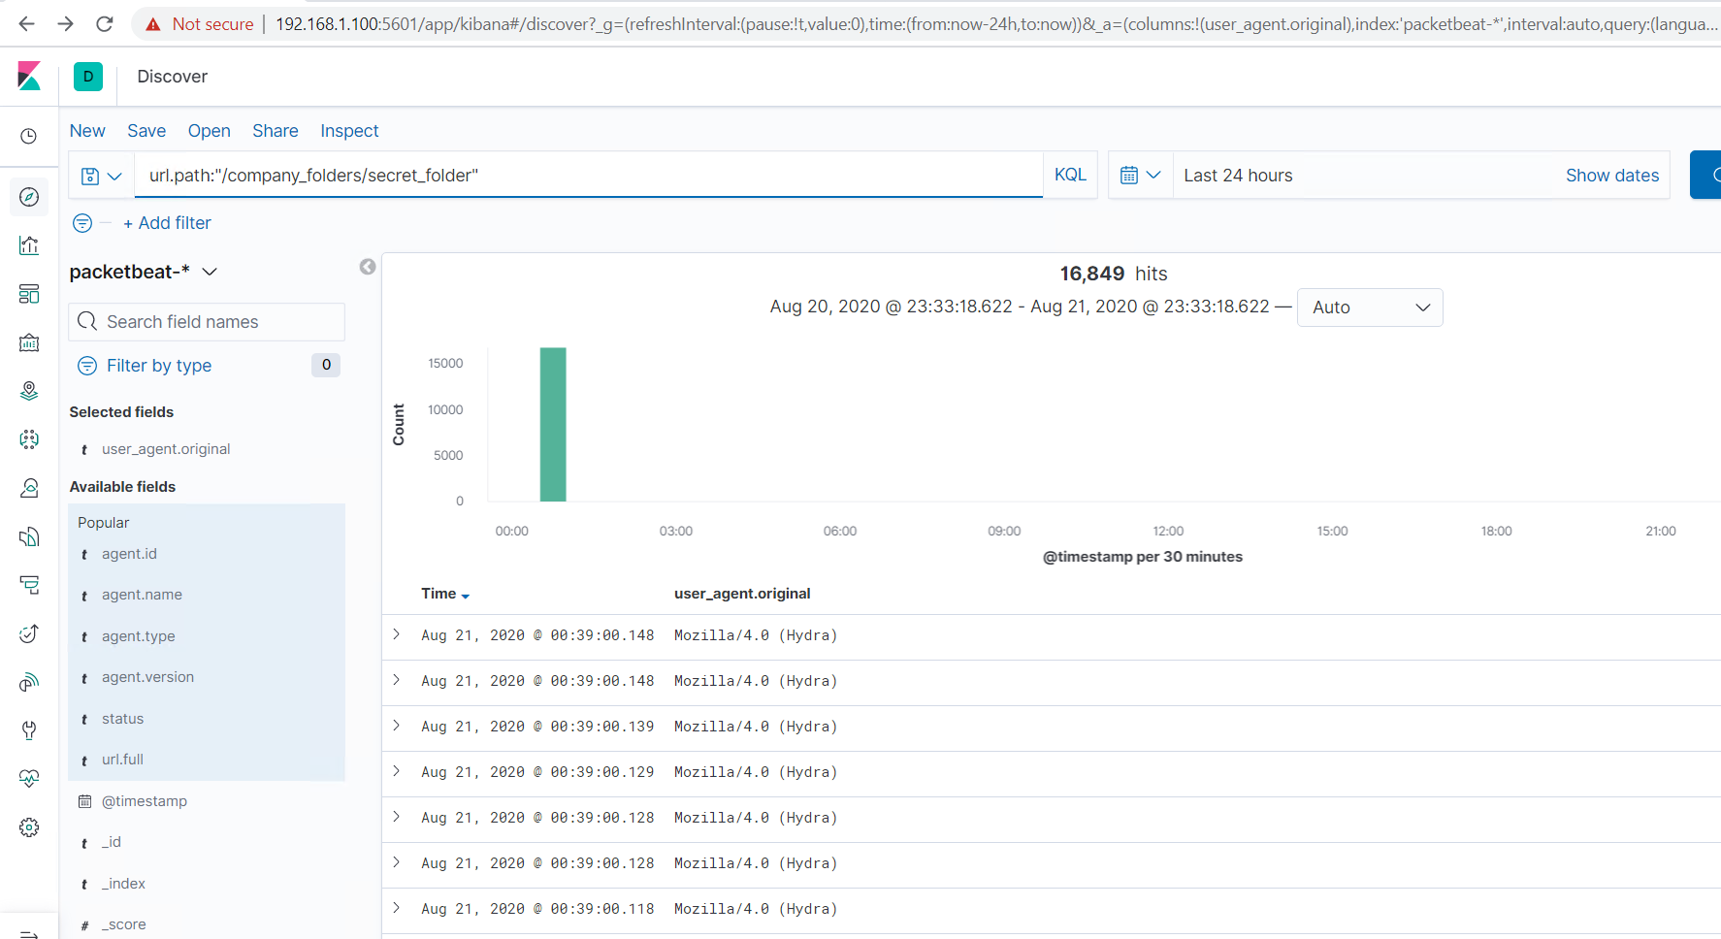
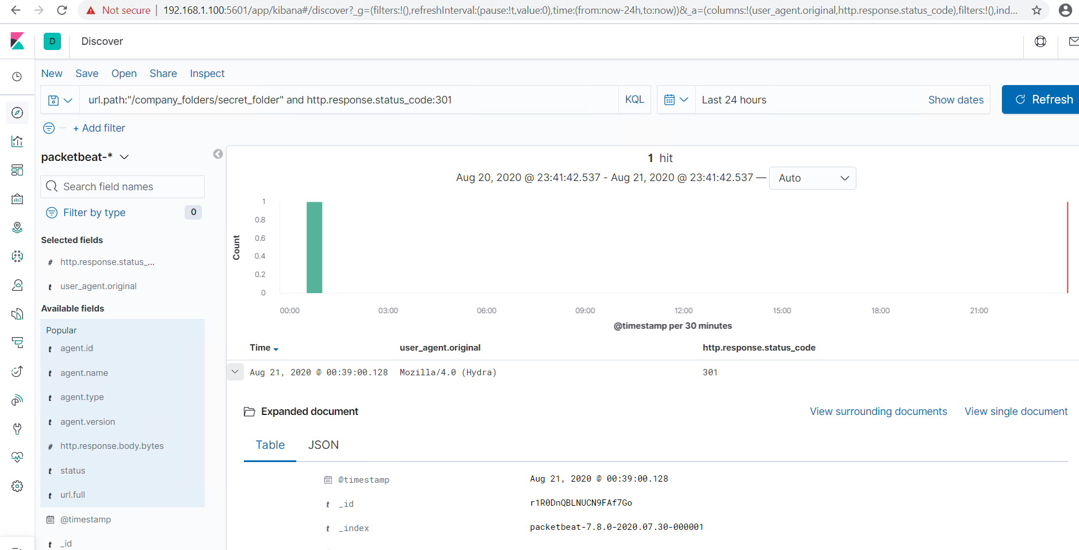
Analysis: Uncovering the Brute Force Attack
There were 16,849 packet requests made by a Brute Force Attack (specifically, Hydra). The http response code 301 indicates a successful discovery of the correct password and was redirected to another web page.

Slide 15
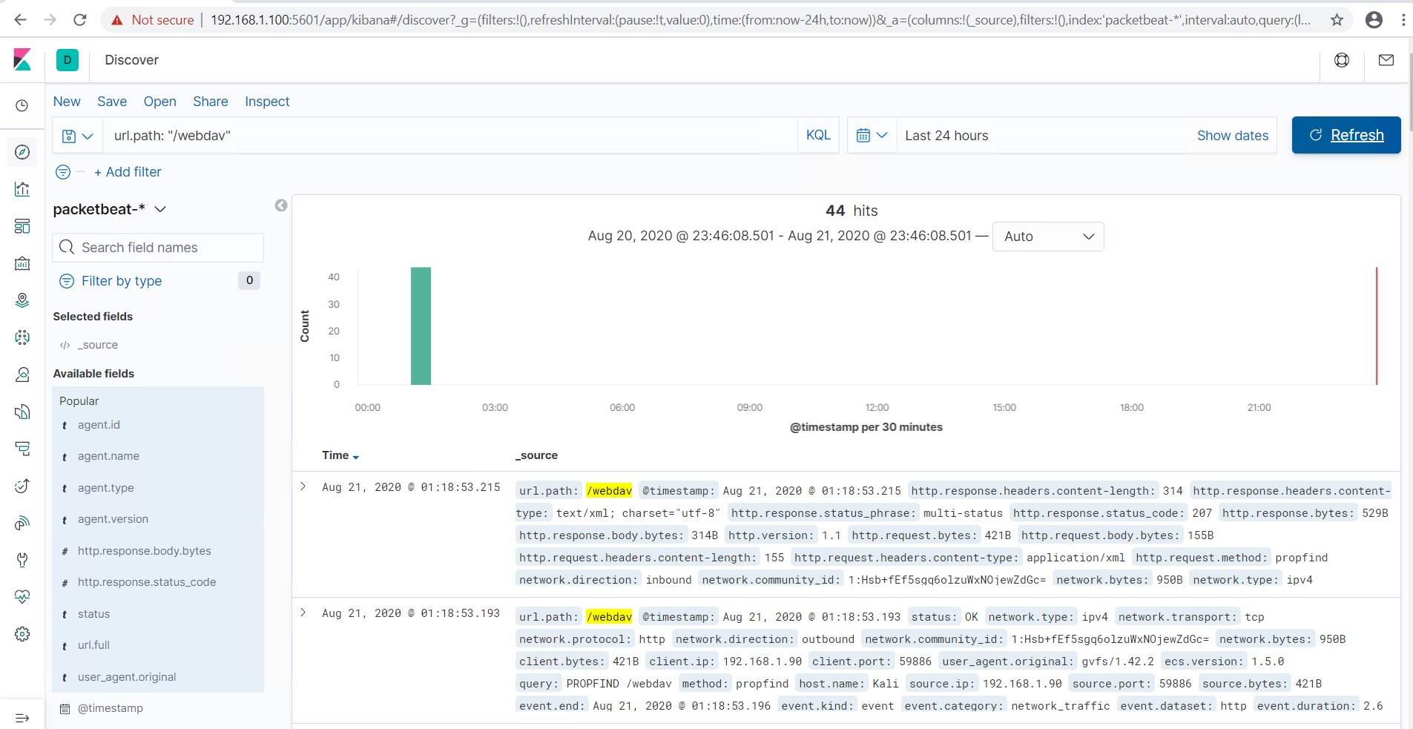
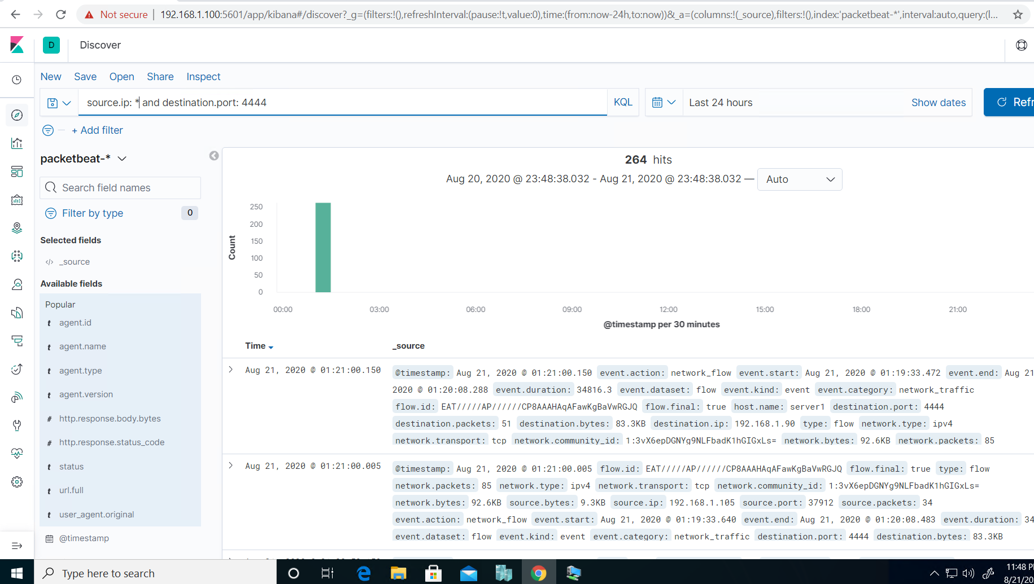
Analysis: Finding the WebDAV Connection
There were 44 hits to the WebDAV connection where the files exploit.php and passwd.dav were requested. The PHP reverse shell was uploaded to start a Metepreter shell session.

Slide 16

Blue Team
Proposed Alarms and Mitigation Strategies
This Photo by Unknown Author is licensed under CC BY-SA
16

Slide 17
Mitigation: Blocking offensive traffic
Alert
System hardening
Alert if a large amount of traffic occurs in a short time from a single source IP that targets multiple ports.
10 port scans in one minute or 100 consecutive ping (ICMP) requests.
Enable only the traffic you need to access internal hosts and deny everything else.
Configure firewalls to look for malicious behavior and have rules in place to cut off attacks if a certain threshold is reached.

Slide 18
Mitigation: Finding the Request for the Hidden Directory
Alert
System hardening
Alert if there are requests for the hidden directory from an unauthorized user.
By whitelisting authorized users, the hidden directory will have limited access.
Stronger usernames and password requirements for users that have access to the hidden directory.
Create a whitelist for authorized IP addresses.
Make the folder private by changing permissions.

Slide 19
Mitigation: Preventing Brute Force Attacks
Alert
System hardening
Alert if there are many failed logins from the same IP address and/or logins for a single account from many different IP addresses.
Alert if there are any Hydra attempts.
More secure password requirements.
Limiting the number of attempts that a password can be tried.
Locking accounts out after unsuccessful login attempts.
Using CAPTCHA (human vs machine input)

Slide 20
Mitigation: Detecting the WebDAV Connection
Alert
System hardening
Alert if requests are made from port 4444.
Alert if a PHP file is uploaded using the WebDAV protocol.
Avoid storing instructions for accessing the server that can be accessed by a web browser.
Make sure software patches are up-to-date.
Disable WebDAV or make sure it’s configured correctly.

Slide 21
Mitigation: Identifying Reverse Shell Uploads
Alert
System hardening
Alert if invalid file types are uploaded to the web server.
Alert if any port is open.
Alert on any traffic that is not expected.
Store uploaded files in a location not accessible from the web.
Manage privileges of all users to control access to sensitive files.
Define valid types of files that the users should be allowed to upload.

Slide 22
The end
Any Questions?

